Slide 1
AI - The Future of Work
GBG Keynote
Subrat Panda, Principal Architect
Capillary Technologies
AI First - Thought Leader

Slide 2

Brief Introduction about me
BTech ( 2002) , PhD (2009) – CSE, IIT Kharagpur
Synopsys (EDA), IBM (CPU), NVIDIA (GPU), Taro (Full Stack Engineer), Capillary (Principal Architect - AI)
Applying AI to Retail
Co-Founded IDLI (for social good) with Prof. Amit Sethi (IIT Bombay), Jacob Minz (Synopsys) and Biswa Gourav Singh (AMD)
https://www.facebook.com/groups/idliai/
Linked In - https://www.linkedin.com/in/subratpanda/
Facebook - https://www.facebook.com/subratpanda
Twitter - @subratpanda

Slide 3
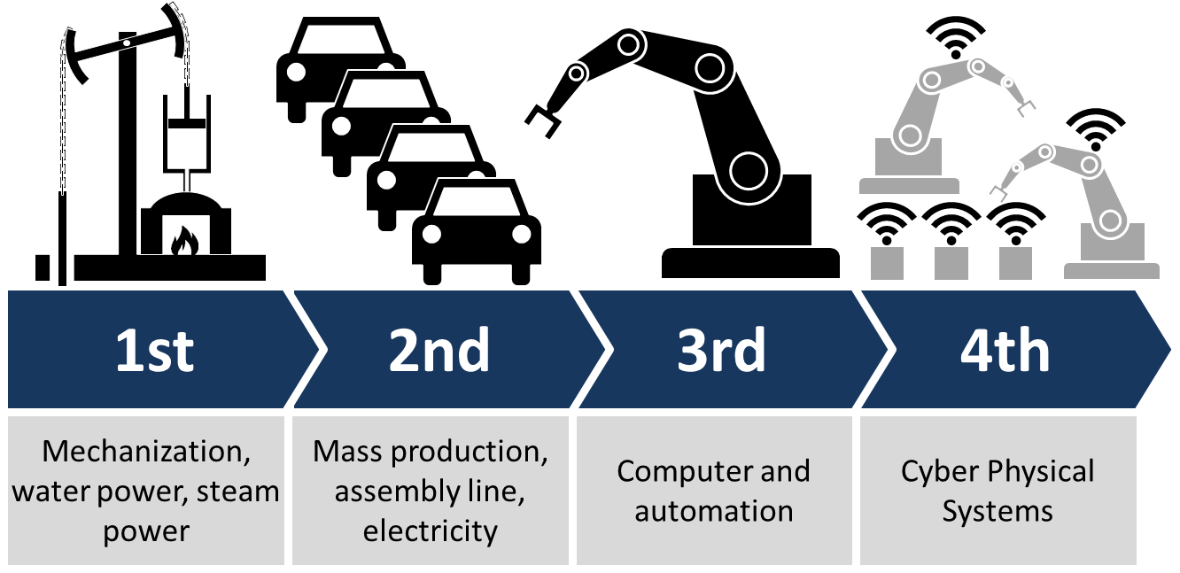
Industry 4.0
Interoperability
Information transparency
Technical assistance
Decentralized decisions
https://en.wikipedia.org/wiki/Industry_4.0

Slide 4
Knowledge is Power - Sir Francis Bacon
Industry 4.0 enabled by IoT, BigData and AI
IoT is the intelligent sensor
BigData will enable processing huge volumes of data
AI will make sense of the data in decision making
AI helps transform raw data into power - AI will transform businesses for sure
Primarily Machine Learning and then the deeper aspects with Deep Learning
AI is the bedrock on which Industry 4.0 relies on.

Slide 5
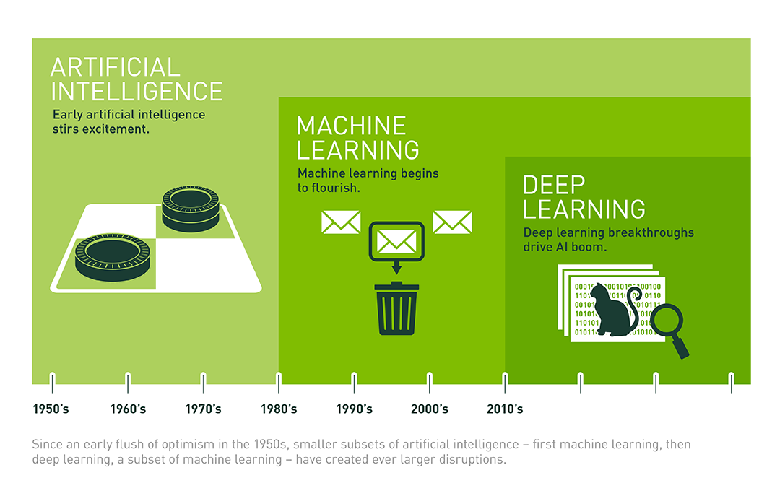
The AI landscape

Slide 6
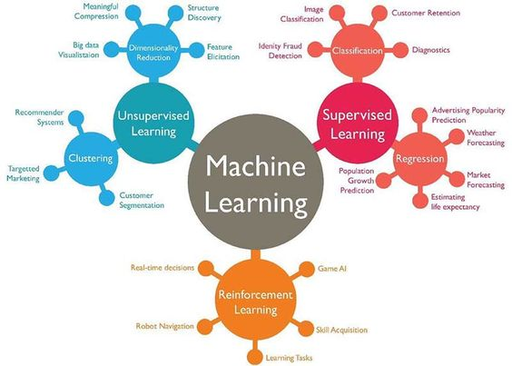
Machine Learning – http://techleer.com

Slide 7
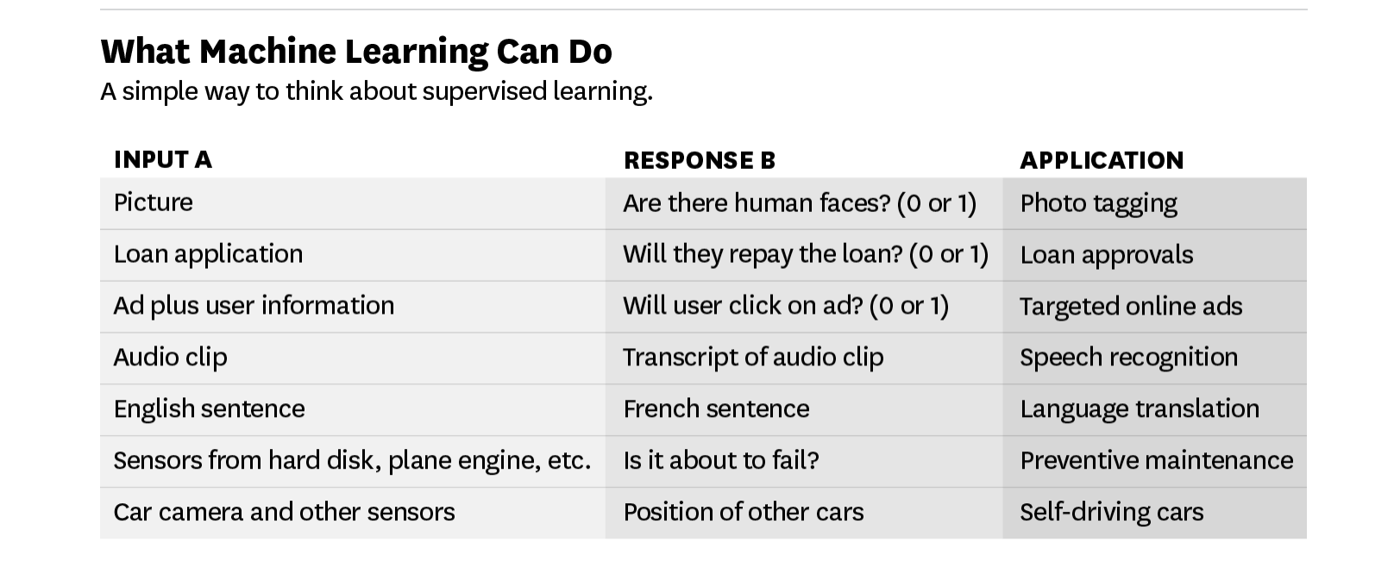
What AI can and cannot Do today ?
https://hbr.org/2016/11/what-artificial-intelligence-can-and-cant-do-right-now

Slide 8
Supervised Learning
Being able to input A and output B will transform many industries.
The technical term for building this A→B software is supervised learning.
The best solutions today are built with a technology called deep learning or deep neural networks, which were loosely inspired by the brain.
Basically labelled data is the most important requirement for Supervised Learning.
If a typical person can do a mental task with less than one second of thought, we can probably automate it using AI either now or in the near future. - Andrew Ng

Slide 9
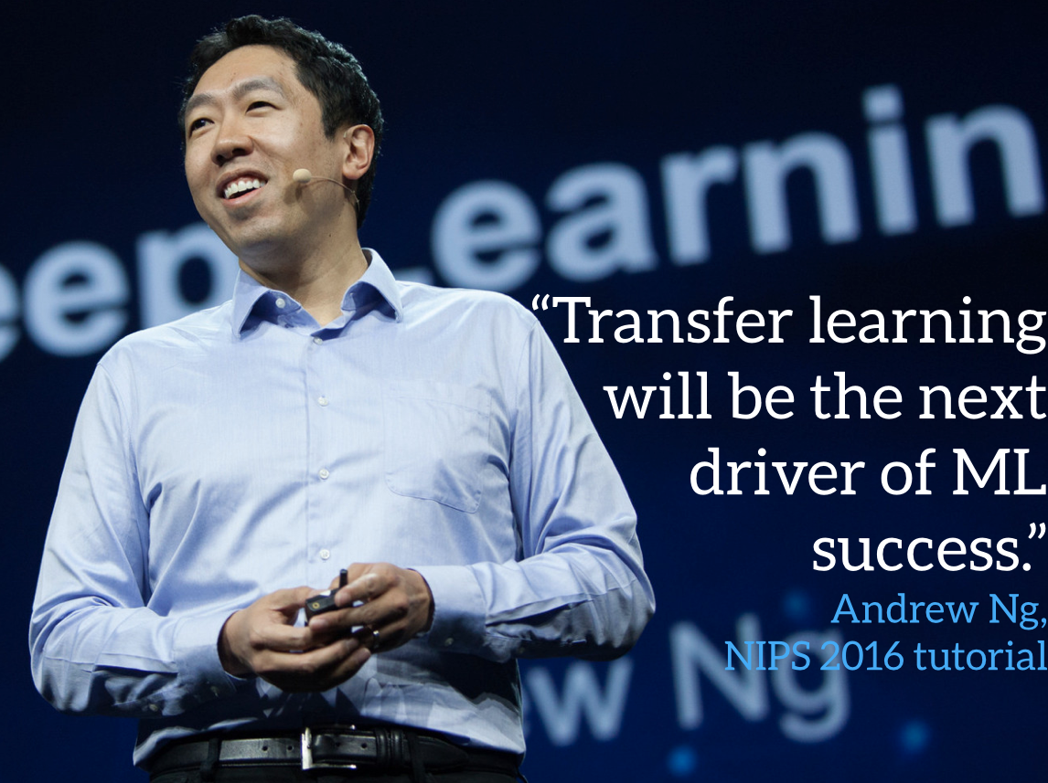

Slide 10
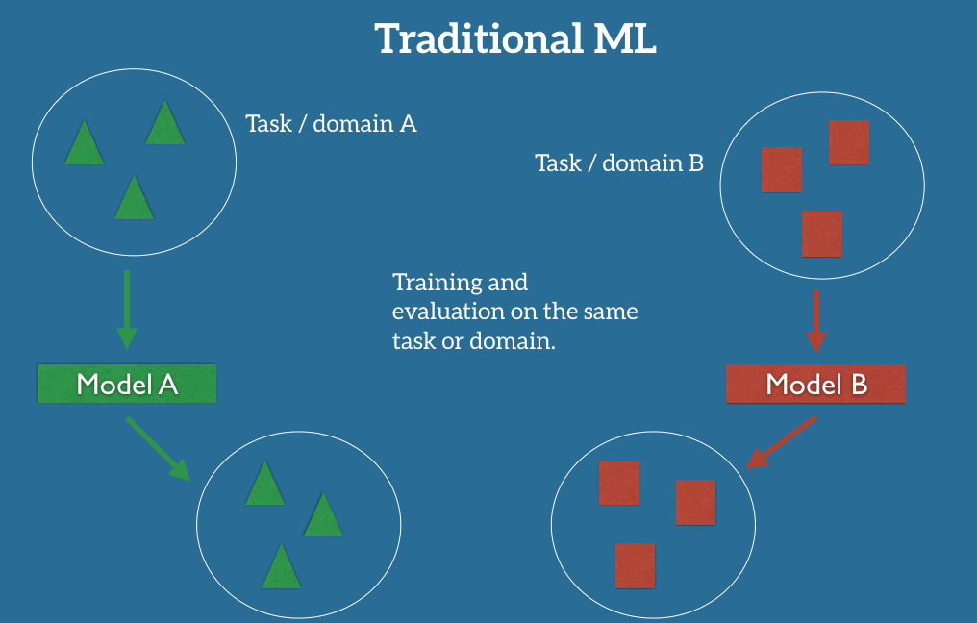
Transfer Learning - http://ruder.io/transfer-learning/

Slide 11
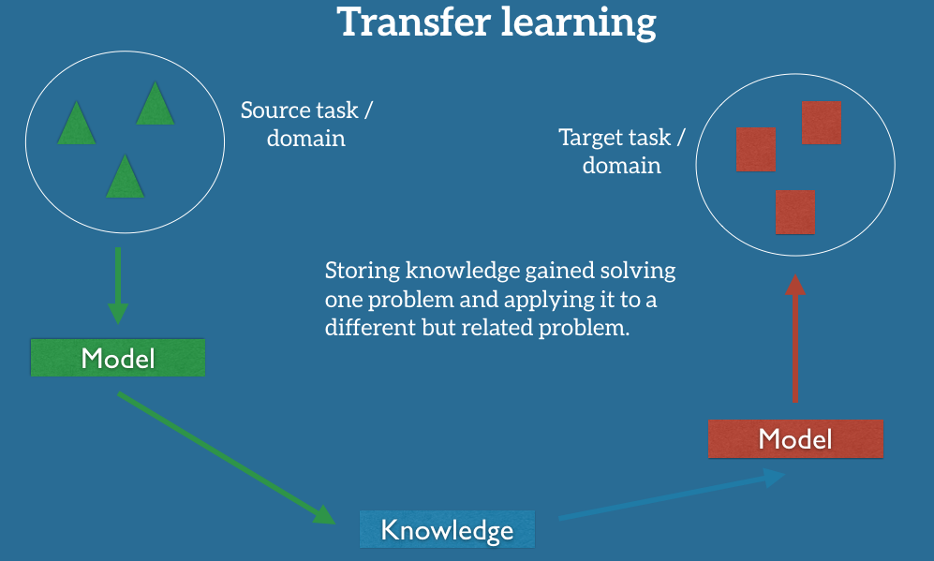
Transfer Learning - http://ruder.io/transfer-learning/

Slide 12
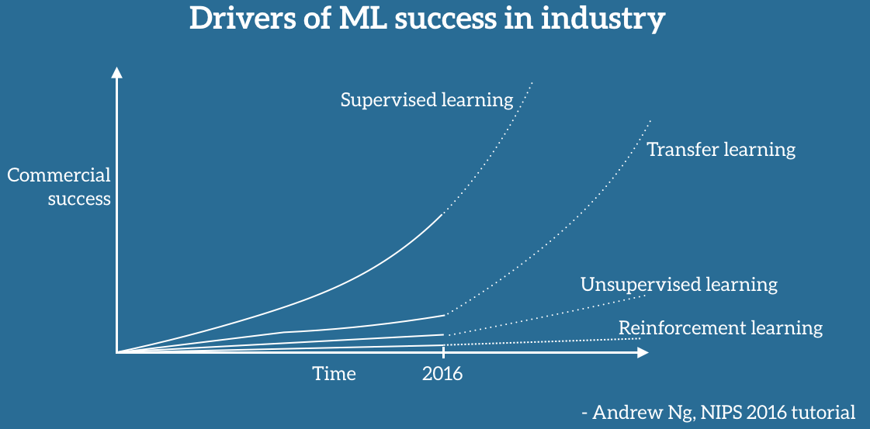
Drivers of ML Success

Slide 13
Corporate Strategy - AI
Very important to understand where value is created and what’s hard to copy. The AI community is remarkably open, with most top researchers publishing and sharing ideas and even open-source code.
Algorithm has become a commodity.
In this world of open source, the scarce resources are therefore:
Data - Data, rather than software, is the defensible barrier for many businesses.
Talent - Simply downloading and “applying” open-source software to your data won’t work. AI needs to be customized to your business context and data. This is why there is currently a war for the scarce AI talent that can do this work.
Domain Expertise + Data + Software ==> Scalable AI strategy
Quoting Andrew Ng here.

Slide 14
Data Strategy or Data Governance
AI solutions won’t work for you unless you have a clear cut data strategy
Data acquisition
Data curation
Data normalization
Data protection
Data ingestion
Data Extraction at scale
Platforms need to be built and is very specific to the problem one is working on.

Slide 15
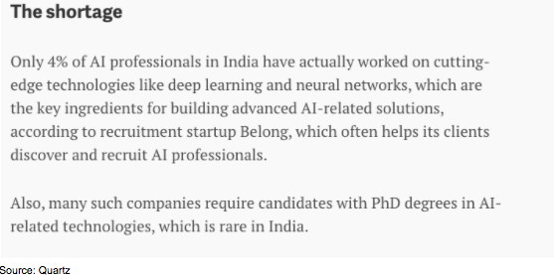
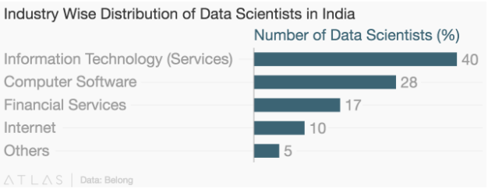
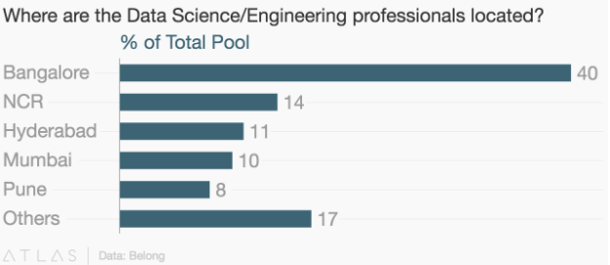
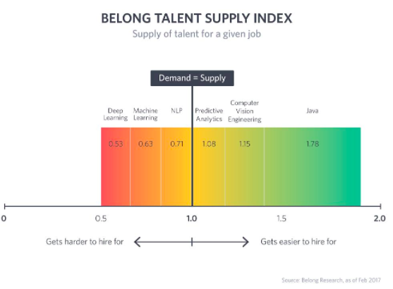
Talent Strategy
http://blog.belong.co/can-india-supply-her-companies-with-artificial-intelligence-talent

Slide 16
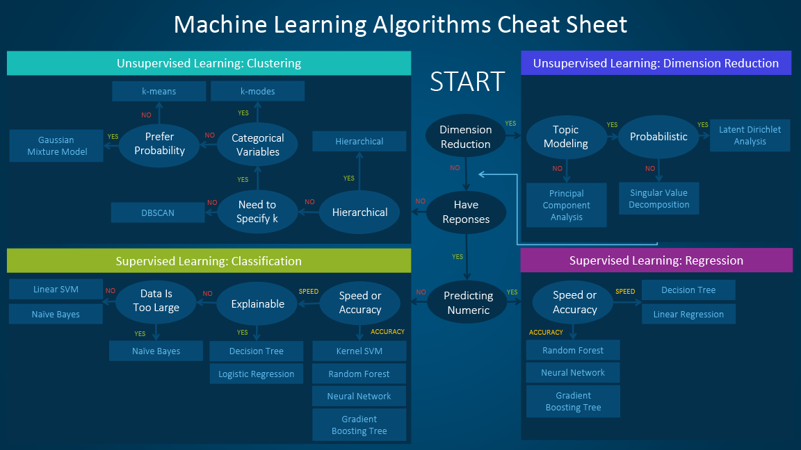
Talent Strategy
Deep Domain Expertise - You already have an edge
Upskill folks in AI - depending on the data that you are dealing with
They should be able to do the following:
The size, quality, and nature of data.
The available computational time.
The urgency of the task.
What you want to do with the data.
https://blogs.sas.com/content/subconsciousmusings/2017/04/12/machine-learning-algorithm-use/

Slide 17
When am I ready to adopt AI ?
Can the Use-case be enhanced by the use of AI ?
Am I/Customer comfortable with the probabilistic nature of AI solutions ?
Do I have enough data ?
Is the !/$ spent on AI based solution worthy of investment ?
Do I have the timeline to iterate and improve/experiment ?

Slide 18
Risks in AI Adoption
Yet the biggest harm that AI is likely to do to individuals in the short term is job displacement, as the amount of work we can automate with AI is vastly bigger than before.
You need to understand your data better.
If you cannot create differentiation with data it is a problem.

Slide 19
Traditional Applications of AI in Retail
Customer Segmentation
Inventory Management
Recommender Systems
Campaign Management
Insights

Slide 20
Neo-AI in Retail
Enhanced Inventory Management – Takes care of other factors which could have been hard to decipher.
Enhanced Recommender Systems
Customer Engagement – Chatbots based interface (NorthFace – using IBM Watson)
Consumer Insights – Deep Understanding of Stores and Customers
Logistics and Delivery – Robots and Drones
Others – AI powered Gift Selection

Slide 21
Using Computer Vision in Retail
Video analytics, derived through computer vision, helps retailers answer many critical questions, including:
How many shoppers entered the store?
What are my shoppers’ gender and age ranges?
Where do shoppers go in my store (and where do they not go)?
Where do shoppers stop and engage with fixtures or sales associates?
How long do they stay engaged?
Which are my most effective fixtures, and which ones are underperforming?
RetailNext integrates a variety of sensor technologies as part of its “technology stack” in building its platform
Reference: https://retailnext.net/en/blog/computer-vision-sees-better-than-2020/

Slide 22
How we do this ?
How many shoppers entered the store? – People Counting
What are my shoppers’ gender and age ranges? – Demographic Analysis
Where do shoppers go in my store (and where do they not go)? - Heatmap
Where do shoppers stop and engage with fixtures or sales associates? – Shoppers Tracking
How long do they stay engaged? – Tracking and Identification
Which are my most effective fixtures, and which ones are underperforming? – Peel Off Counters
All of these can be solved using AI.

Slide 23
Q and A ?
What were your key takeaways ?

